Slide 1
CNLAB Final Project
Detect DDoS Attacks via SDN
Group 8
B07902002 連崇安 B07902034 王昱凱 B07902126 謝宗儒

Slide 2
Motivation
emergence of DDoS attacks can lead to abnormalities in the related network services
detection of DDoS attacks is an important topic in the field of network security
software defined network (SDN) brings up some novel methods to this topic

Slide 3
Functions of the Project
Create Environment by Mininet and Ryu
Generate DDoS Attacks
Implement Detection of DDoS Attacks
Implement Mitigatation of DDoS Attacks
Compare Results Between Different Methods

Slide 4
Create Environment
Network Topology ( Mininet )
Controller Modules ( Ryu )
Learning Module
DDoS Detection Algorithm

Slide 5
DDoS Attack : 使用工具 hping3
hping3 is a TCP / IP packet assembler / analyzer for
Firewall testing
Advanced port scanning
Network testing, using different protocols, TOS, fragmentation
Advanced traceroute, under all the supported protocols
Remote uptime guessing
TCP/IP stacks auditing.
Notes:
防火牆測試 壓力測試 檢查網路

Slide 6
DDoS Attack : TCP flood example
hping3 -SARUPF -p [dst_port] --flood –rand-source [dst_ip]
-p --destport
--flood sent packets as fast as possible
--rand-source random source address mode.
-SARUPF:
S =SYN, A =ACK, F =FIN, R =RST, P =PUSH, U =URG

Slide 7
DDoS Attack : UDP flood example
hping3 –udp -s [src_port] -p [dst_port] -a [fake_src_ip] --flood [dst_ip]
-p destination port
-s source port
--flood sent packets as fast as possible
-a spoof source address

Slide 8
DDoS Attack : ICMP flood example
hping3 –icmp -p [dst_port] --flood -a [fake_src_ip] [dst_ip]
-p destination port
--flood sent packets as fast as possible
-a spoof source address

Slide 9
DDoS Attack resource
https://www.bilibili.com/read/cv3580712/
https://tools.kali.org/information-gathering/hping3
https://mochazz.github.io/2017/07/23/hping3/#Syn-Flood%E6%94%BB%E5%87%BB

Slide 10
Detection of DDoS Attacks
Simulation ( on our virtual machine )
Dataset ( on an open source dataset )

Slide 11
Detection of DDoS Attacks by Simulation
Entropy-Based Detection
SVM Detection

Slide 12
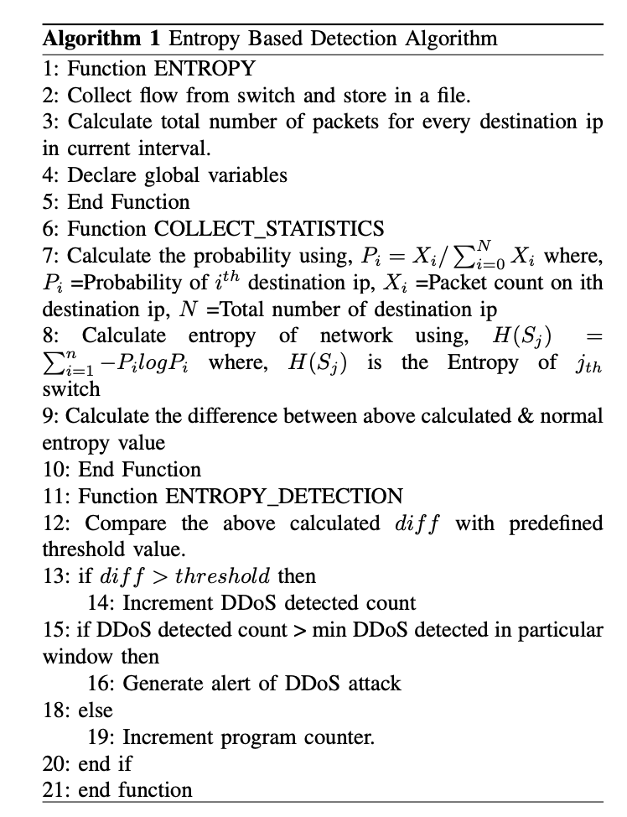
Entropy-Based Detection
Reference:
Mousavi, S.M.; St-Hilaire, M. Early detection of DDoS attacks against SDN controllers.

Slide 13
Drawbacks of Entropy-Based Detection
Entropy detection cares not about time factor. (Could raise false alarm when sending packets at low rate.)
Determine a “good” threshold value could be problematic. (We could use ML to help us find a good threshold value.)
It’s pretty straight foward and non-flexible as a binary classifier.

Slide 14
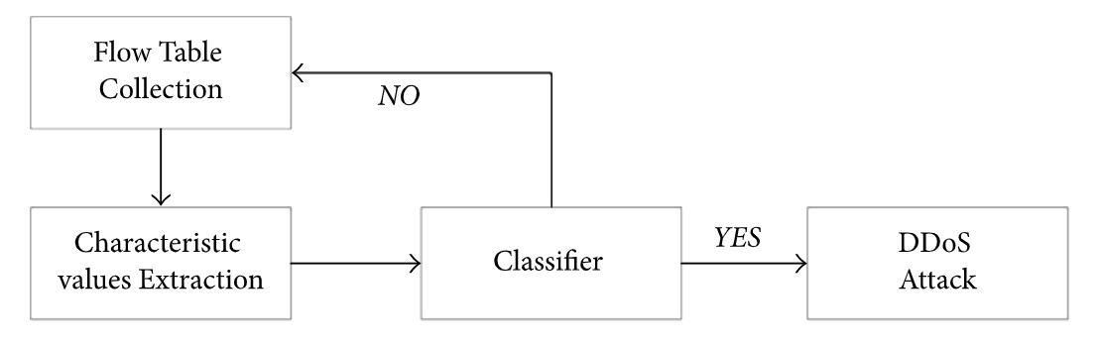
SVM Detection
Reference :
Jin Ye, Xiangyang Cheng, Jian Zhu, Luting Feng, Ling Song, "A DDoS Attack Detection Method Based on SVM in Software Defined Network"

Slide 15
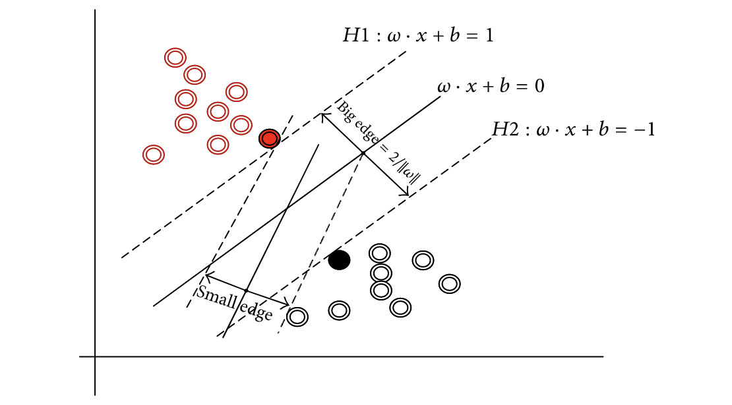
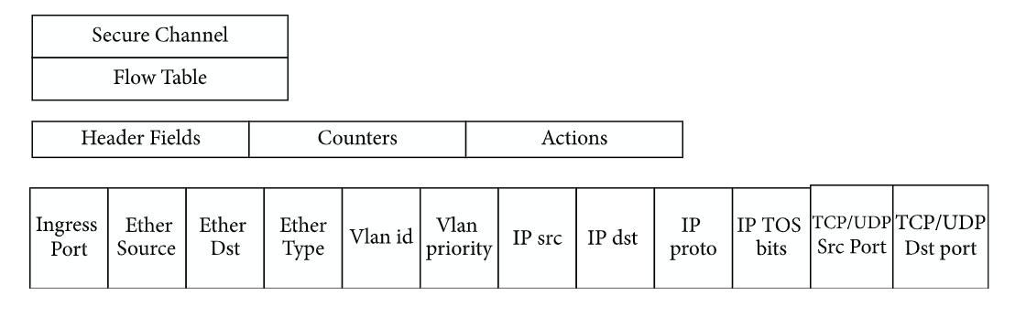
SVM Detection
Data
( flow table )
SVM

Slide 16
Collect Data
$ sudo ovs-ofctl dump-flows ( execute this command every 5 seconds )
1. SSIP (speed of source IP)
2. SDFP (standard deviation of flow packets)
3. SDFB (standard deviation of flow bytes)
4. SFE (speed of flow entries)
5. RPF (ratio of pair flow)

Slide 17
Advantages and Disadvantages of SVM
Advantages
higher accuracy
Disadvantages
need to collect data for training
spend more time

Slide 18
Mitigation of DDoS Attack
when DDoS attack is detected:
delete the dataflow ( not very effective )

Slide 19
DEMO

Slide 20
Detection of DDoS Attacks on Dataset
Creates ten topologies in mininet and collects data from switches
DDoS Attack : TCP Syn attack, UDP Flood attack, ICMP attack
Extracted Features from Switches : Switch-id, Packet_count, byte_count, duration_sec, ...
Calculated features : Packet per flow, Byte per flow, Packet Rate, number of Packet_ins messages, total flow entries, ...
Reference : https://data.mendeley.com/datasets/jxpfjc64kr/1

Slide 21
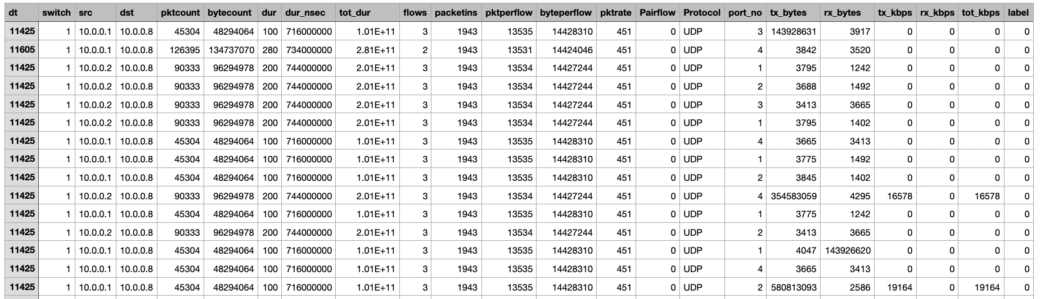
Dataset Features

Slide 22
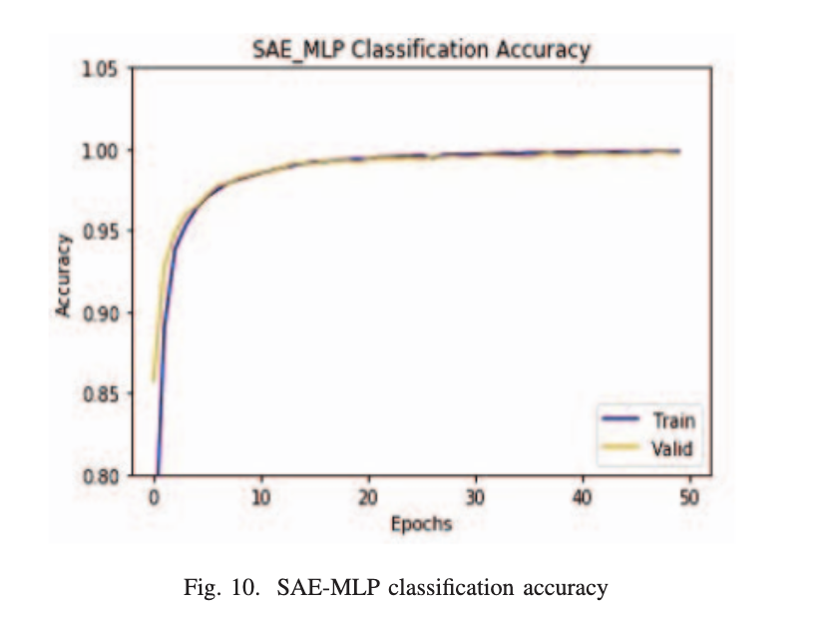
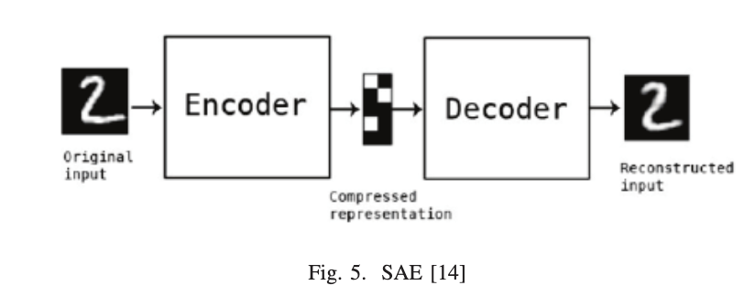
Related Works
Limitation : cost much time to train and predict
Reference : N. Ahuja;G. Singal;D. Mukhopadhyay. DLSDN: Deep Learning for DDOS attack detection in Software Deﬁned Networking

Slide 23
Detection of DDoS Attacks on Dataset
ML - Based Methods:
SVM
KNN ( K-nearest neighbors )
Decision Tree
Random Forest

Slide 24
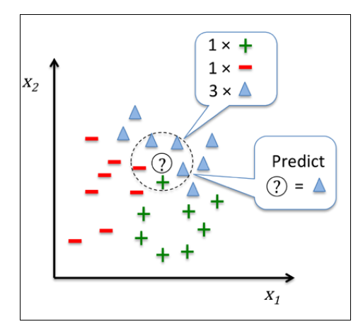
KNN
The k-nearest neighbors (KNN) algorithm is a simple, supervised machine learning algorithm to solve classification problems.
Each prediction is decided by the voting result of its k- nearest neighbors.
It's easy to implement and understand, but would be significantly slows if the size of that data in use is large.

Slide 25

Decision Tree
Decision Tree is a Supervised learning technique in machine learning that can be used for classification.
Internal nodes represent the features of a dataset, branches represent the decision rules and each leaf node represents the classified outcome.

Slide 26
Decision Tree
strengths:
classifying rules are readable and explainable
easy to visualize the process
easy to analyze the results
weaknesses:
tend to overfit
tend to ignore correlation between features
bad performance on imbalanced data set

Slide 27
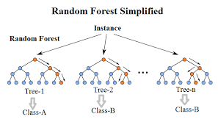
Random Forest
Random forests is an ensemble learning method for classification by refering to multiple decision tree outcomes to “democratically” decide the final classification.
It can largely reduces the overfitting phenomenon in decision trees and helps to improve the accuracy.

Slide 28
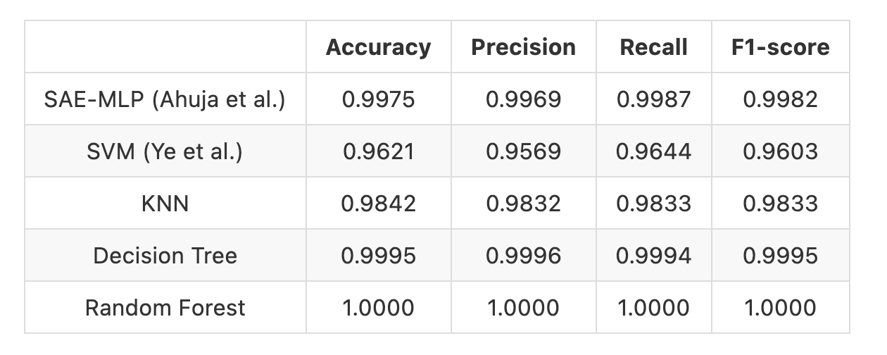
Comparing Performance

Slide 29
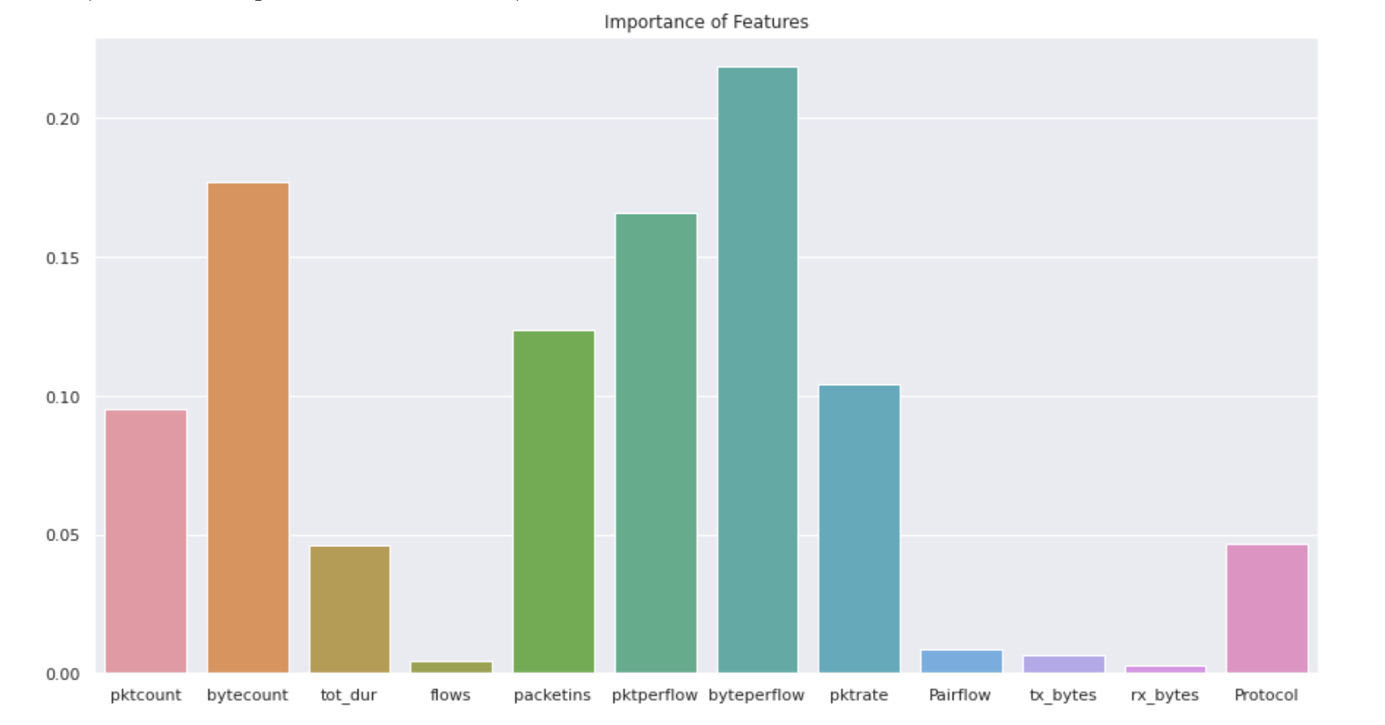
Data Analysis

Slide 30
Data Analysis
byteperflow:
Under normal circumstances:
sending the data packets is relatively large
Under attack:
in order to achieve the attack effect, usually sends data as soon as possible
the data packets are relatively small and unchanged
byte per flow will be relatively small

Slide 31
Conclusion
Find out better methods for DDoS attack detection, which improves detection performance and requires less time
The results of different detection methods would be more reliable if performing on data which is closer to reality
Mitigation is as important as detection of DDoS attack

Slide 32
System Structure
Network Topology ( Mininet )
Controller Modules ( Ryu )
Learning Module
DDoS Detection Algorithm
Mitigation Technique

Slide 33
Expected Results
compare the correctness of detection between different methods
successfully mitigate DDoS attack

